Slide 1
Opportunities and Potentials for
Cyprus and Beyond
25 June 2018
Hilton Park Hotel, Nicosia, Cyprus
Stavros Nicolaou

Slide 2

BRICS Business Council 2018
Briefing Document prepared for Minister Davies – 31 May 2018

Slide 3


Background
The BRICS Business Council was launched in March 2013 at the 5th BRICS Summit in Durban
Inaugural Meeting held in Durban in August 2013
In July 2018, the BRICS Business Council returns to its origination point for its 6th Annual Meeting during South Africa’s tenure as BRICS Chair

Slide 4
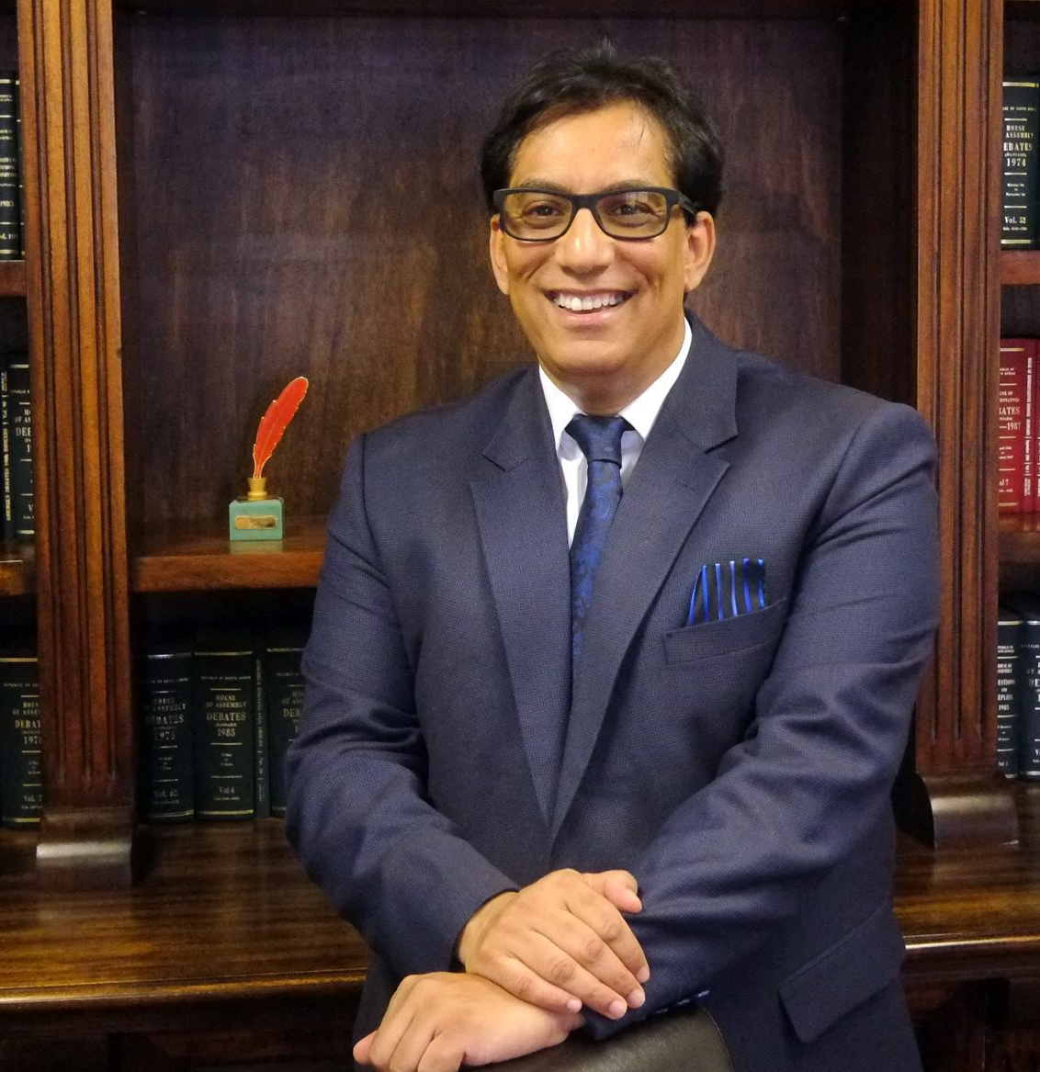
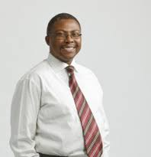
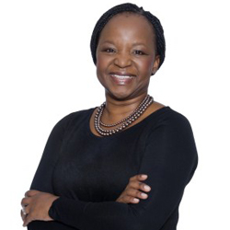
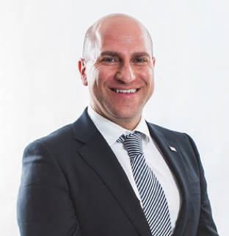
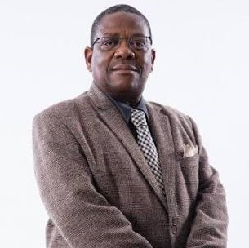
South African Chapter of the BRICS Business Council
Dr Iqbal Survé
Chairman
The Sekunjalo Group
Mr Siyabonga Gama
Transnet
Ms Busisiwe Mabuza
Business Unity South Africa
Mr Stavros Nicolaou
Aspen Pharmacare
Mr Sello Rasethaba
Black Business Council (Acting)

Slide 5

Role of the Council
To identify key industries and sectors to promote, encourage and facilitate alliances among BRICS businesses
To encourage and facilitate the engagement and participation of local and sectoral business associations in the South African BRICS Business Council, to ensure no duplication of efforts and to leverage additional resources

Slide 6

THEMES FOR OUR CHAIRSHIP
Youth - Fostering Entrepreneurship
4th Industrial Revolution and the Digital Economy
Food Security
“
”
BRICS Business Council of SA 2018

Slide 7

Youth – Fostering Entrepreneurship
Almost half of the world’s youth live in the BRICS countries.
The BRICS Business Council can help them succeed by fostering their innovative and entrepreneurial spirit.

Slide 8

4th Industrial Revolution and the Digital Economy
The 2nd BRICS Skills Competition will be held in South Africa in 2018. Focus areas will include:
  Cyber Security
  The Internet of Things
  Data Analytics
  Industrial Robotics
  Intelligent Manufacturing.

Slide 9

Food Security
About 41 % of the World’s population live in the BRICS countries, and a third of all farmland is in BRICS countries.
The Agribusiness Working Group in collaboration with BRICS institutions are organizing to develop an MOU on a Seed Bank for the BRICS Countries.

Slide 10

The Working Groups - The Engine of the BRICS Business Council
  Appoint members, hold regular, minuted meetings
  Ensure there is a strategy and work programme
  Provide regular feedback to the SABBC
  Liaise with business and business associations

Slide 11
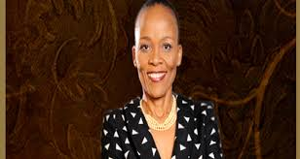


Working Group – Agri-business
Chair
Slauzy Mogami
Past Achievements
Conducted discussions to promote sustainable forest management, the elimination of trade barriers, and the expedition of the development of forest products trade.
Looking Forward
Proposal of MOU for establishment of a BRICS Seed Bank

Slide 12
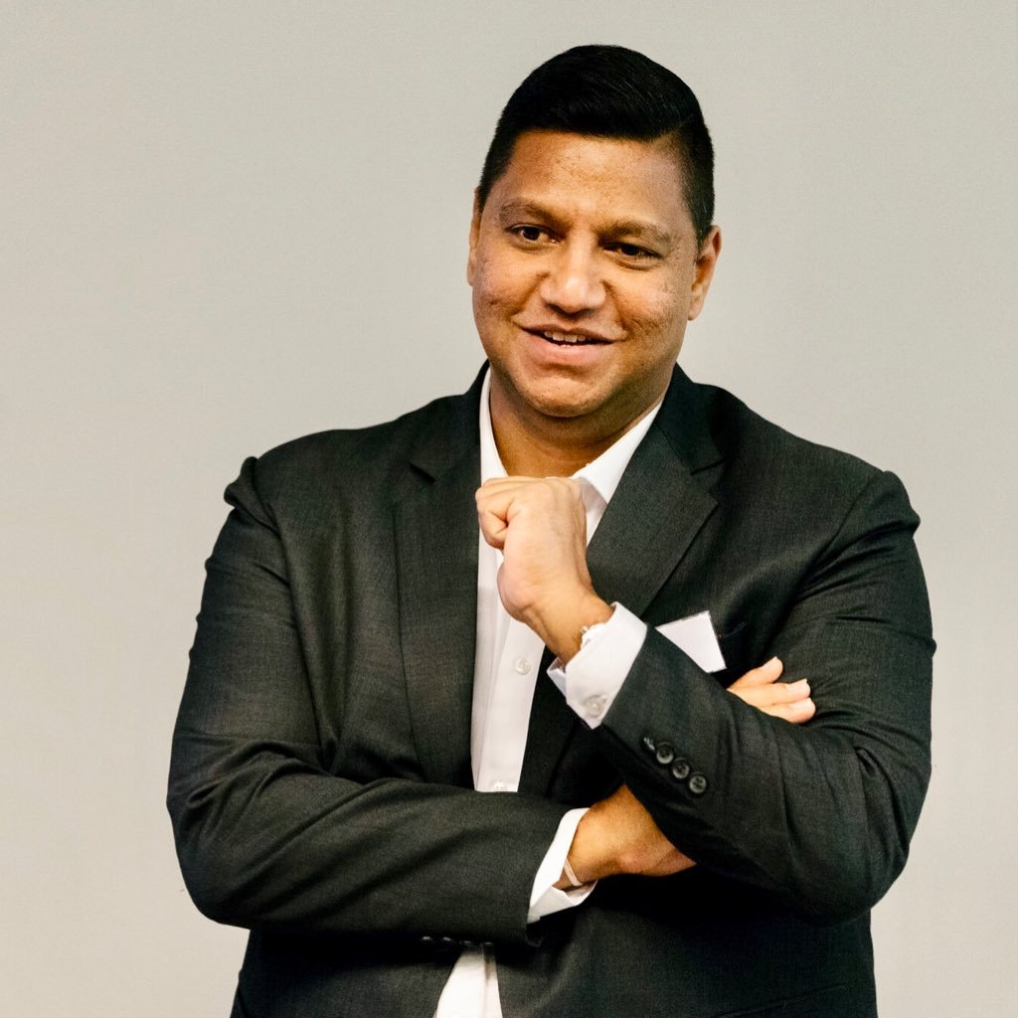
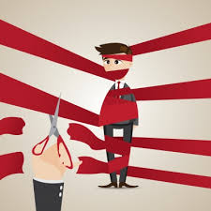
Working Group - Deregulation
Chair
Sunil Geness
Looking Forward
Easing border controls to enable Africans to more freely do business
Past Achievements
South Africa has signalled its commitment to a ten-year visa for foreign businesses.

Slide 13
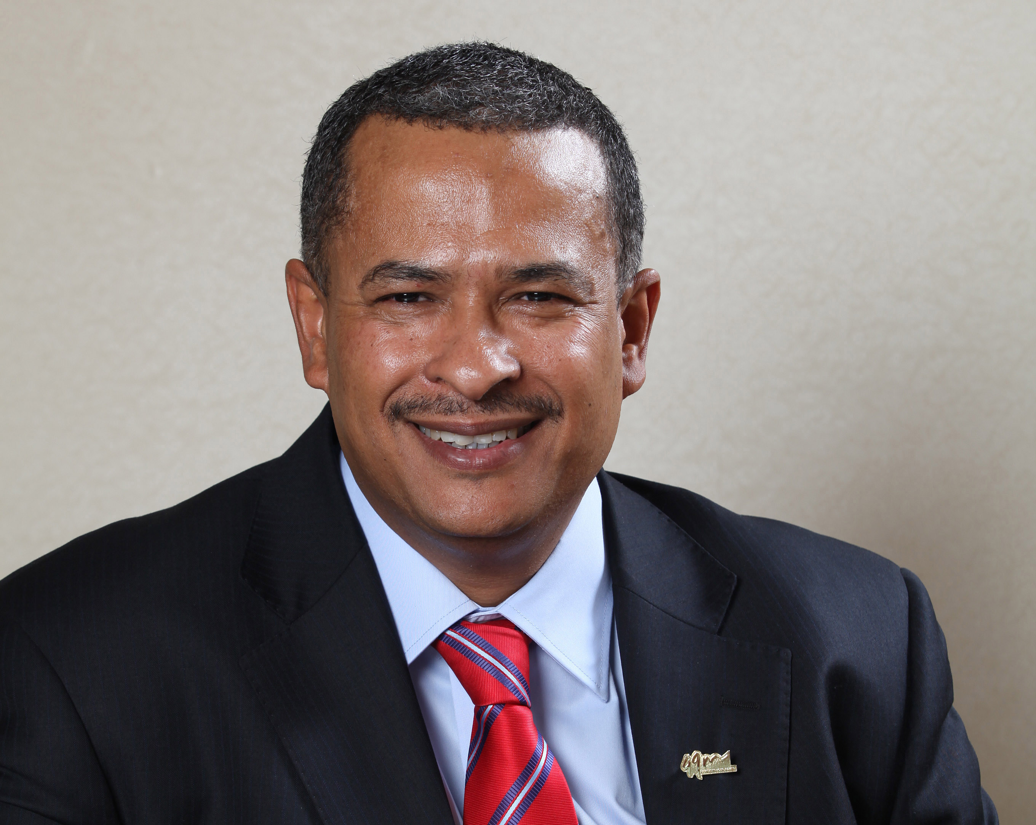


Working Group – Energy and Green Economy
Chair
Brian Dames
Past Achievements
Proposed the creation of a BRICS Energy Excellence Centre in Africa
Looking Forward
MOU with the New Development Bank (NDB) on a Clean Energy Fund (EGE WG)

Slide 14
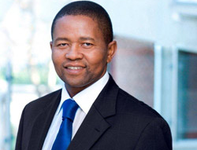
Working Group – Financial Services
Chair
Geoffrey Qhena
Looking Forward
Establishment of a BRICS Credit Rating Agency
BBC – NDB MOU Implementation Document ;
New International Card Payment System (NICPS) Project Endorsement;
Establishment of a network of Sovereign Wealth Funds;
Implementation of the signed Insurance and Reinsurance Support Framework and
Establishment of a Small Medium Enterprises Fund (SME) and Infrastructure Financing Fund.

Slide 15
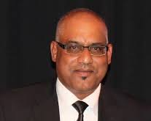
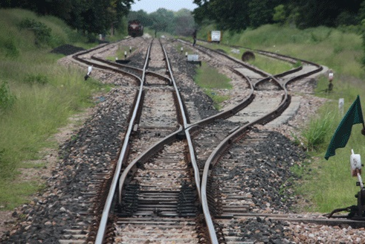
Working Group – Infrastructure
Funding Achievements
Funding of Transnet & Saldehco – Public Private Partnership Project
NDB funding of Durban container berth project
Memorandum of Understanding with Chang’an University
Transnet-RZD (Russian Railways) Cooperation Roadmap
Establishment of Mahindra Vehicle Plant in Durban
R10bn funding of Musina-Makhado Special Economic Zone
Looking Forward
Launch of Infrastructure Portal
Partnership with NEPAD Agency/AU
Transport Network Development
Skills Transfer Programme
African Union’s North South Development Corridor
Electricity generation and transmission infrastructure in Africa
Chair
Ravindra Nair

Slide 16
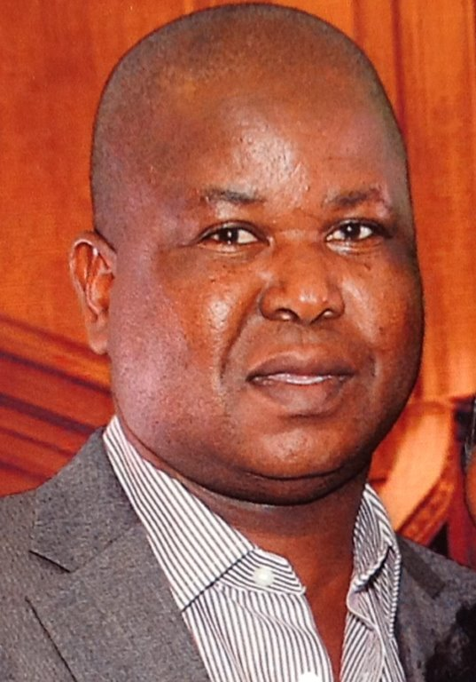
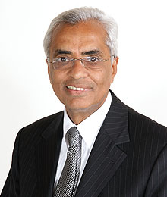

Working Group - Manufacturing
Past Achievements
Organized an Academic Information Exchange between Aspen and the Far East University of the Russian Federation
The import to South Africa of plant and machinery from India and China with the associated technology and skills transfer agreements
Co-chairs
Gilbert Mosena
Nizam Kalla

Slide 17
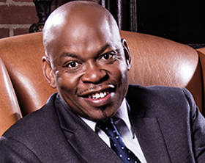


Working Group – Regional Aviation
Co-chairs
George Sebulela
Javed Malik
Established at the BRICS Business Council Meeting in 2018

Slide 18
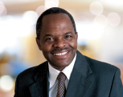

Working Group – Skills Development
Chair
Bhabhalazi Bulunga
Past Achievements
South African participation in the Russian project on Jobs of the Future in the Metals Industry
Conducted skills competitions for skills of the future under the Chair of China
Researched the impact of the 4th industrial revolution on the manufacturing sector in the BRICS economies under the Chair of India
Looking Forward
Hosting BRICS Skills Competition and Skills EXPO SA 2018

Slide 19

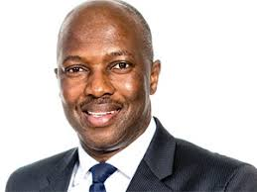
The Newest Working Group – Digital Economy
Chair
Hamilton Ratshefola

Slide 20





BRICS Business Council Notable Achievements
Launch of the BRICS Business Council Website –
SA Chapter
https://www.bricsbusinesscouncil.co.za
Launch of BRICS Business Quarterly Magazine
Signed an MOU with the New Development Bank (NDB)
Declaration on the Establishment of the BRICS Business Women’s Alliance
Researched an internal report on issues of food security in South Africa and on the Continent

Slide 21
Thank you

